Slide 1
Customized - First Choice Submittted By Group No: 10 Pooja Fondekar 210943120068 Pragati Wasnik 210943120071 Harsha Sonawane 210943120031 Mohnish Pawar 210943120054

Slide 2
Introduction
Main motive of doing this project is to fulfill the customer requirements and to build strong customer base. In this project we are going to develop the system where we are providing a multiple option to user so that user can choose as per their requirement and get satisfactory product (Customized product). Also customer can buy raw material from the site. Experience to each segment of users and can drive customer loyalty and increase customer satisfaction.

Slide 3
Our proposed system that is Customized-First Choice modules listed as below.
User Module
Vendor Module
Admin Module

Slide 4
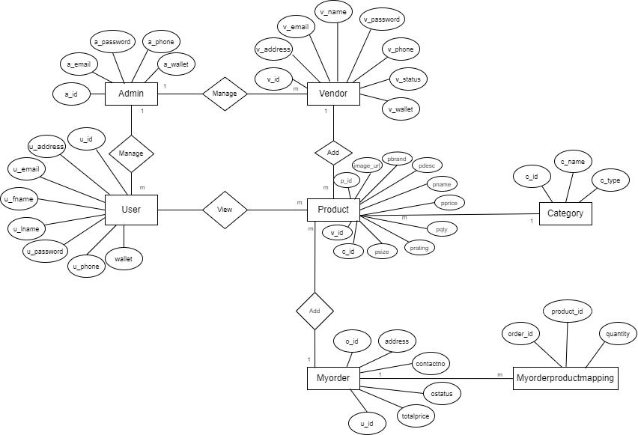
ER Diagram

Slide 5
Software Requirement Specification Hardware: Intel i3Processor 3rdGeneration 4 GB ddr3ram. Windows 10 Home edition orlater. 200 GB SATA HDDSpace Data Connection 200Kbps Software: Frontend-REACTJS Backend-Springboot Database-MySQL5.7withWorkbench 8.0 ApacheTomcatServer9

Slide 6
Future Scope
The further development in the project is to provide a product as per customer requirement like customer will choose the material and provides a dimensions and according to that customer will received stitched product.

Slide 7
Thank You

